Slide 1
Air Quality Mapping
Robert Mouncer
Rdm10
140150025

Slide 2
Every solution needs a problem.
Notes:
The problem at hand
How it links to industrial year

Slide 3
What was the project set to achieve?
A solution to effectively monitor air pollution levels and the ability to visualise the data in a proactive way.
Notes:
Two main systems for monitoring and visualisation
1 step in the guide to improve air quality

Slide 4
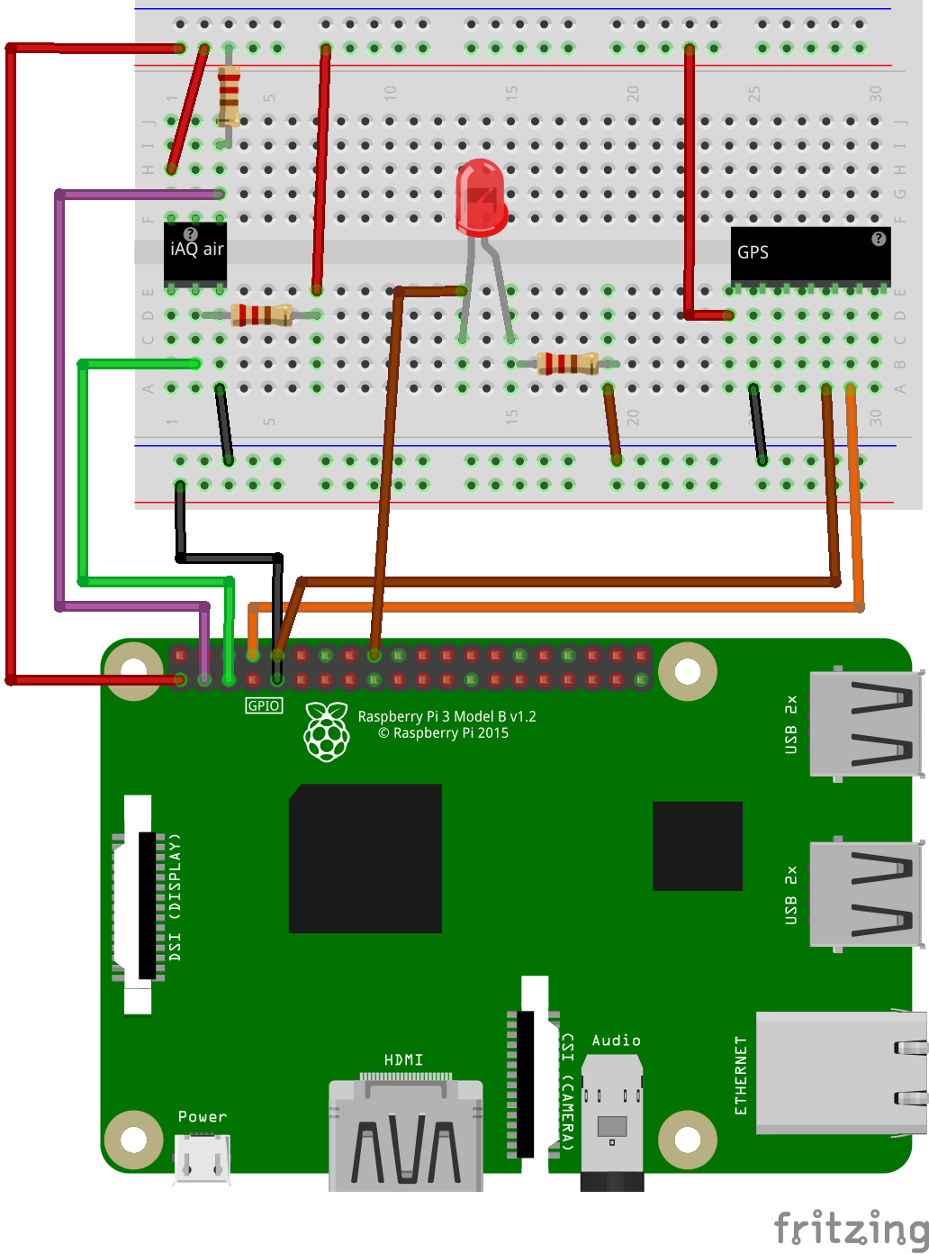
Monitoring system - Hardware
Notes:
Original design
Problems with I2C (voltage divider and pull up resistor)
LED

Slide 5
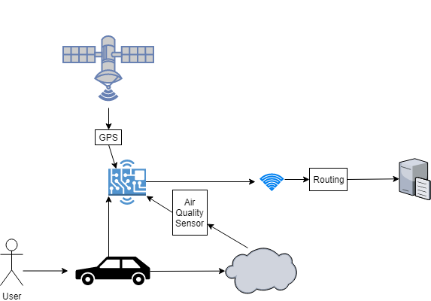
Monitoring system - Software

Slide 6
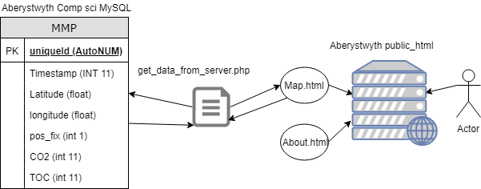
Visualisation System
Notes:
Very similar to implementation

Slide 7
Known Bugs
Data Logging not starting correctly
Heat-map very buggy and not showing intensity correctly

Slide 8
Future work
Contribute to open source project Leaflet.heat to help fix bugs or recreate an alternative
Correct bugs in the data logger
Expand to measure more harmful gases
Create power supply to connect to vehicles

